Slide 1
House Price Prediction Using Machine Learning
Group 4
Nilisha Makam Prashantha
Sangamithra Murugesan

Slide 2
Project Background And Executive Summary
Purchasing a house is major life decision for most of us.
Fluctuation in real estate prices make the process much more. difficult in predicting the house price.
The aim is to help the home buyer by predicting the house price
Performed using- ANN, Random Forest, KNN and XGBoost.
CRISP-DM methodology

Slide 3
Project bacNeeds and motivation:
kground and eNNsodihhNKHxecutive summary
Needs and motivation
The existing tools for the price prediction is based on the hype in the market.
Resulted in unfair estimation of price.
Help home buyers make best purchasing decisions.
Deliverables
An optimized machine learning model to predict the house price
We target to predict the house price using the quantitative characteristics: number of room, Location, Crime rate, School rate and GDP.

Slide 4
Project Requirements
Functional Requirements
Python Libraries
Beautifulsoup for data extraction and web scraping
Jupyter Notebook,Google Colab for pre-preprocessing and executing the models
Google Cloud for storing the data
Evaluation metrics: RMSE, R2, MAE
Data Requirements
House listing data from Zillow website obtained by web scraping.
School rating data from GreatSchools.org obtained by web scraping.
Crime data from FBI open source website.
GDP data and GDP Per capita open source data obtained from bea.gov and wikipedia.
AI Requirements
Machine learning model including:
Artificial Neural Network
k-Nearest Neighbour
Random Forest
XGBoost

Slide 5
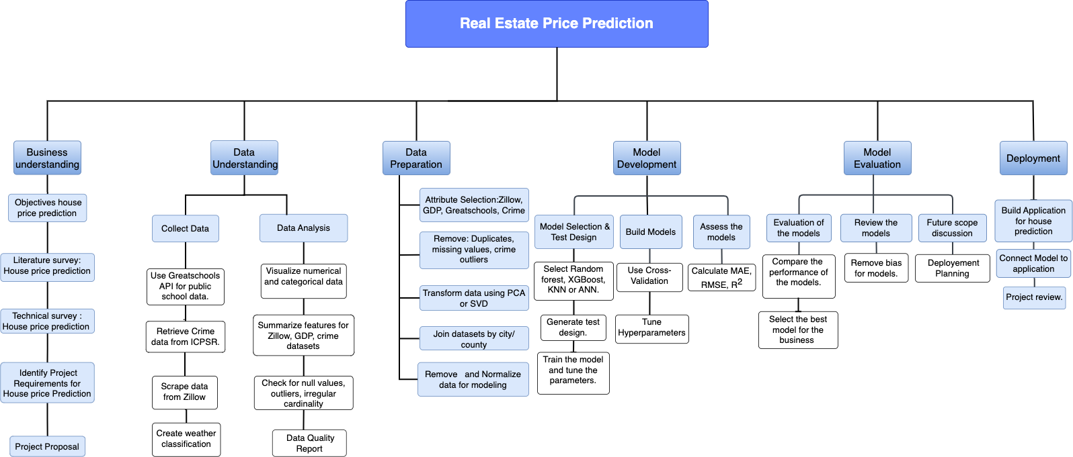
PROJECT PLAN
Notes:
We have followed crisp dm methodology

Slide 6
Technology and Literature Survey
Name | About The Dataset | Models Used | Results
Zillow Home Value Prediction Using Xgboost Rolli C.S(2019) | Collected the house prices data from kaggle. From 3 counties of California(LA, Ventura , Orange) of 2016 | Random forest & XGBoost were the base models selected along with many others for comparison. And used MAE for the metrics. | XGBoost is the best performing model with a negative MAE of -0.05 followed by random forest.
Machine Learning, Deep Learning, and Hedonic Methods for Real Estate Price Prediction Yazani M(2021) | Multiple sources like MLSListings db, Public School Ratings, Crime reports, Walkscore, and the US Census Bureau | Compare performance of ANN, RF and KNN to that of hedonic pricing model. Use RMSE, MAPE and R2 metrics to compare. | In all the metrics, RF outperformed other models and was better at capturing non linearity of the housing market followed by ANN and HP.
Identifying Real Estate Opportunities Using Machine Learning Baldominos A, et al.(2018) | Data is provided by a spanish real estate online platform called idealista. The dataset has real estate listings of 2266 from 2017. Used the data with all the houses costing more than 1 million euros. | SVM, KNN, ensemble of regression trees and multi layer perceptron from ANN. Uses MAE, MSE, R2 | The ensembles of regression trees work significantly better than other models. The author presented that the predicted target had a mean relative error of 16.8%.
Using Machine Learning Algorithms To Analyze The Impact Of Crime On Property Values Angelov P, et al.(2018) | The first data source includes the physical attributes of a property, such as the square footage, quality, the year built or remodeled. The second data source contains the crime data for Pierce County from July 2018 to July 2019. They combined these two data sources into one full dataset. | Decision trees, Artificial Neural Networks, and random forests | They found that Random Forest was the best performed model. Also, using the information gains available from the random forest model, they identified the most to least significant attributes for predicting the property values. The most - Property crime, other crime and year built. The least - the condition of the building.
Notes:
Dataset - All the papers here have collect real estate prices from different places like california, pierce county, spain. In most of the papers we have seen the housing data is mostly compared with multiple factors, either with crime, or public school ratings, we tried to incorporate almost all the factors
Models -
Metrics -
Results -
1.results compared with linear bayesian ridge lasso decision
2. Tries to compare ANN,KNN and RF with hedonic pricing model to check if machine learning models work better or the latter. RMSE score - 0.21 least.
3. Dataset - used data from all residences costing more than one million euros.
4. study to find the impact of crime statistics on property prices in a neighborhood.

Slide 7
Project Resource Requirements and Plan
HARDWARE REQUIREMENTS
SOFTWARE REQUIREMENTS
Name | Specification | Cost | Justification
Google Colab Cloud Server | Intel(R) Xeon(R) CPU @ 2.20GHz, memory- 13 GB, op-mode(s): 32-bit, 64-bit | Free | Executing, versioning, and collaborating with fellow team members to code
Team’s Personal Computer | CPU - 8 core, GPU - 7 core, OS - Mac OS Big Sur, RAM - 16GB Hard disk - 256 GB | 899$ | Scheduling meeting with teammates, working on local disk to run large files(jupyter notebook)
Name | Specification | Cost | Justification
Python | 3.10.7 2.5.1 5 2.1 | Free | Data collection, data preprocessing, and EDA for model development and evaluation
Requests Re Json Pandas NumPy libraries Beautiful Soup Tabula | 2.7.0 22.9.13 1.6.3 1.5.0 1.23.4 4 2.5.1 | Free | Used in data collection methods like web scraping, and editing GDP and crime datasets
Scikit-learn API | 1.1.3 | Free | Used in data transformation, model development, and evaluation
TOOLS & LICENSES
Name | Cost | Justification
Google docs, sheets, slides | Free | Documentation, data filtering and cleaning
Zoom | SJSU sponsored | Team meetings
Jira | Free Trial | Project Management
Draw.io | Free | Creating WBS and PERT charts
SJSU One Search , Google Scholar | Free | Researching literature and technology surveys papers
Grammarly Premium | 100$ | Report Writing
Notes:
Coming to the hardware and software tools used in the project, here is a overview
We used hardware such as google colab’s server and personal computers to perform all teh coding, collaborative activities , and used pc to run any code with a higher ram.
In software tools we used a different kind sof python packages to perform data collection, preparation, cleaning transformation and model development related as well
And coming to other tools used we have used the google workspace , zoom for meeting jira and draw.io to do wbs and project management and finally used grammarly premium for report writing.

Slide 8
Data Flow of House Price Prediction
Data collection
Raw data collected from Zillow, Greatschools, FBI, BEA websites
Data Cleaning
Removed outliers, missing values, unwanted features.
Data Preparation
Split data to train, validation, test sets
01
02
03
04
05
06
Data Exploration
Used Histograms, Box plots, heatmap to find outliers, distributions and correlation among features
Data Transformation
Aggregation on schools, crime features, Merge datasets, Normalization, PCA
Data Modeling
Performed ANN, RandomForest, KNN, XGBoost on the prepared data

Slide 9
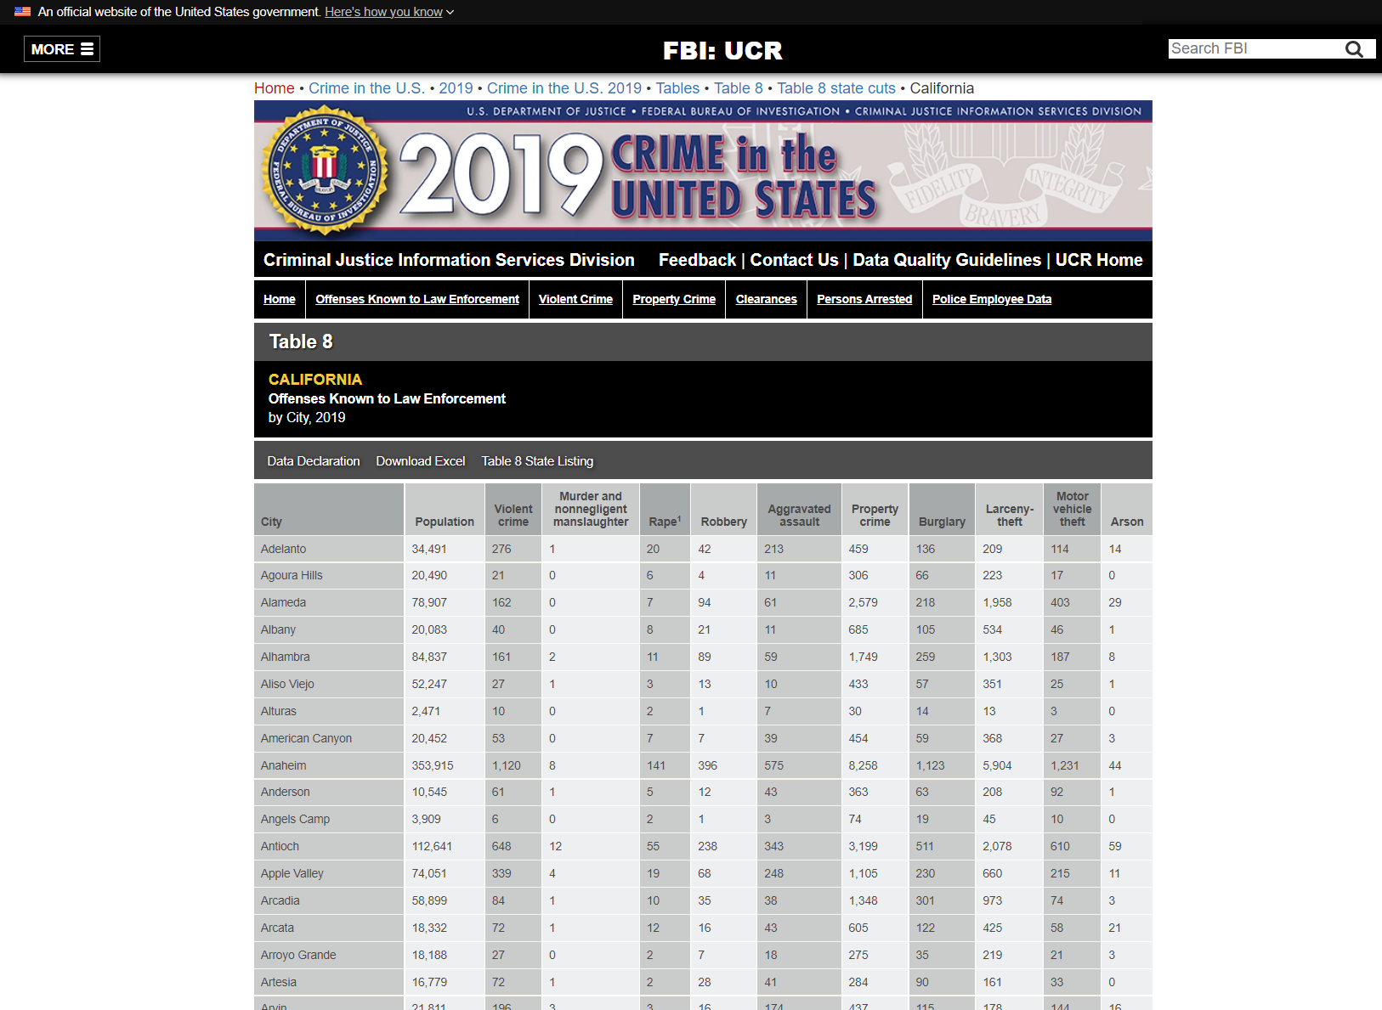
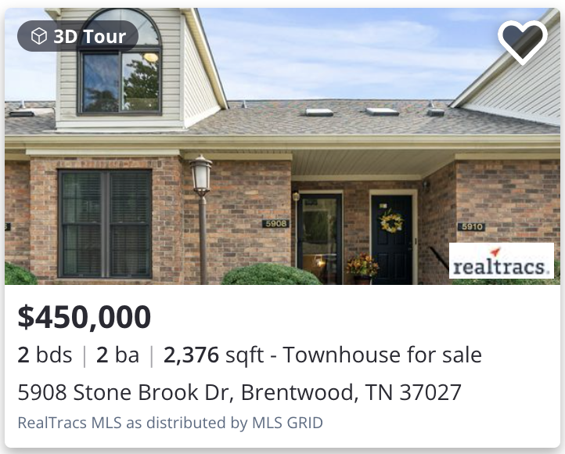
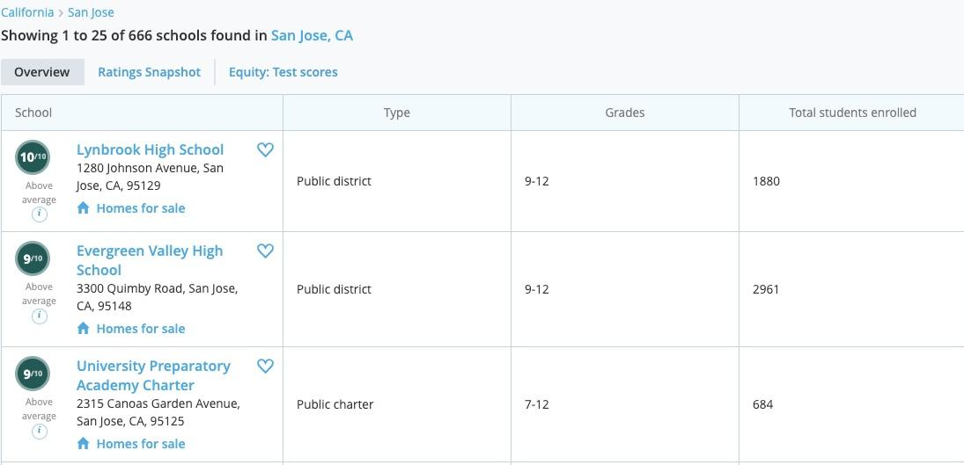
Raw dataset samples
Zillow
Greatschools
Crime

Slide 10
Data Collection
Raw data is collected through web scraping Zillow and Greatschools website using Beautiful soup Python library
Crime data is collected from the official FBI website.
GDP data retrieved as pdf file from Bureau of Economic Analysis website
Dataset | Statistics ( Rows x Columns ) | Size
Houses | 16530 x 54 | 23.3 MB
GDP | 3323 x 7 | 181.9 KB
GDP per Capita | 58 x 6 | 2.8 KB
Crime | 463 x 12 | 77 KB

Slide 11
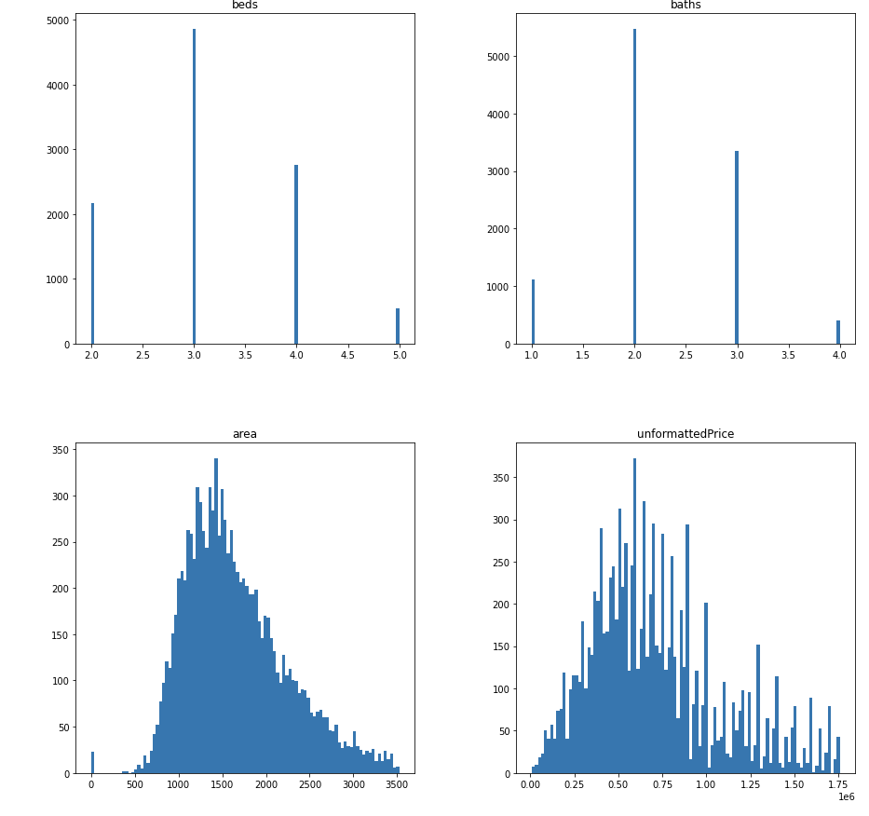
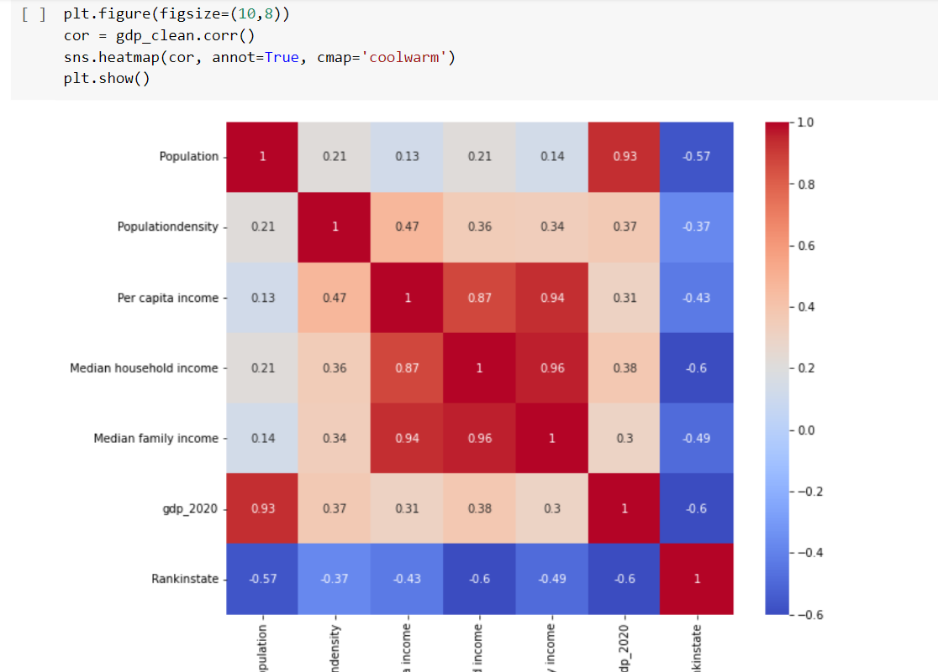
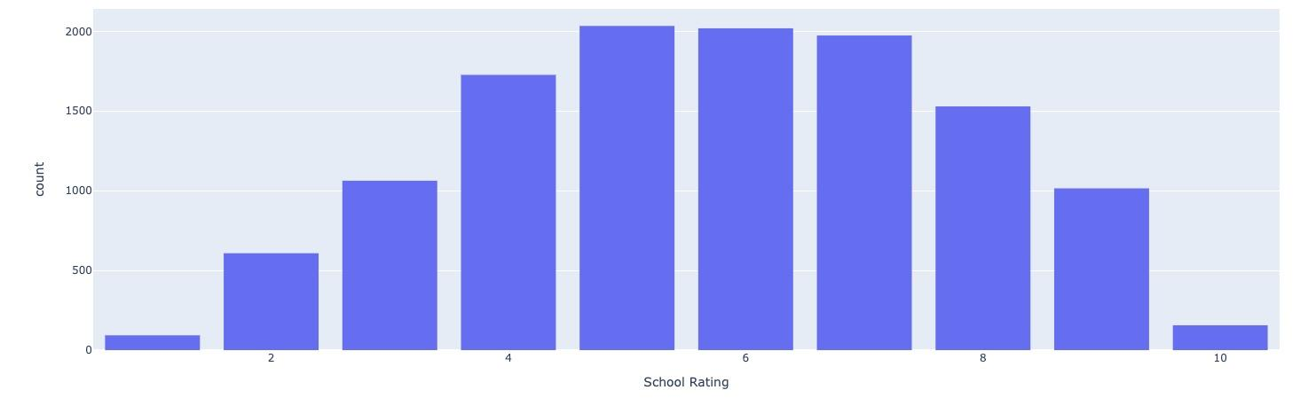
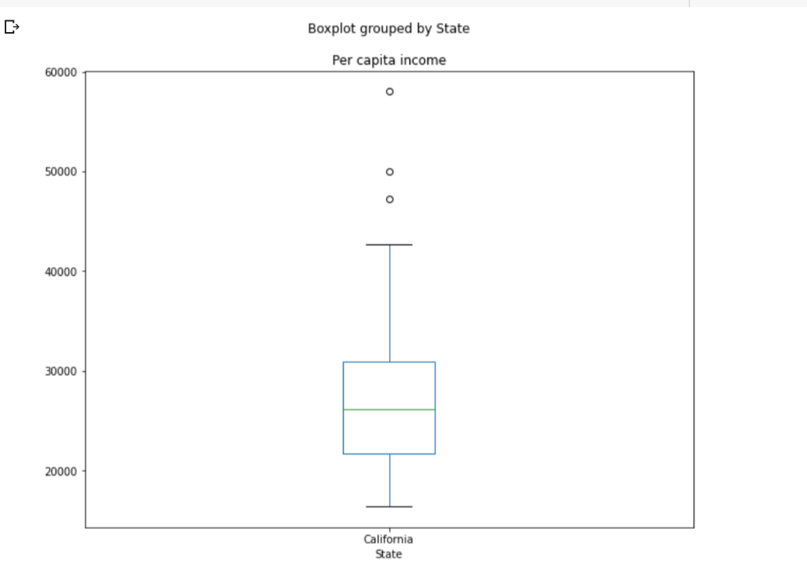
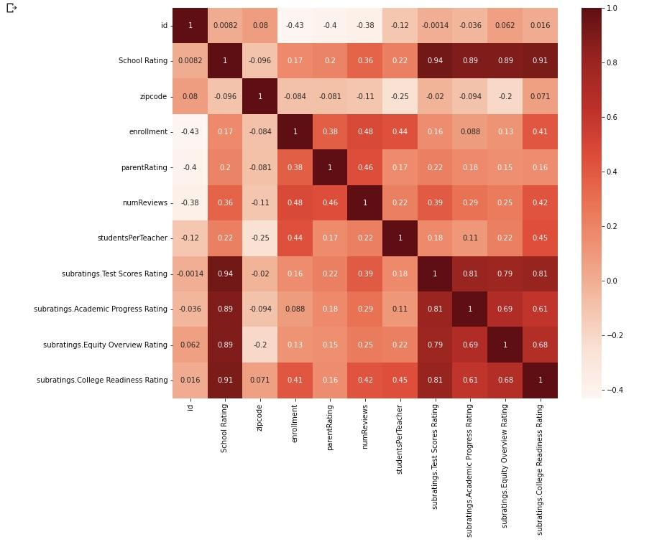
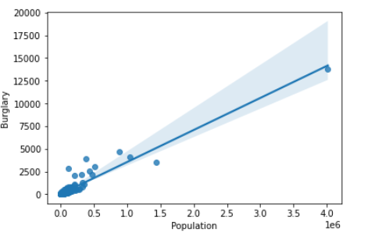
Data Pre-Processing : EDA To Find The Characteristics Of The Data For Each Dataset
Housing Dataset
Crime Dataset
GDP Dataset
Schools Dataset

Slide 12
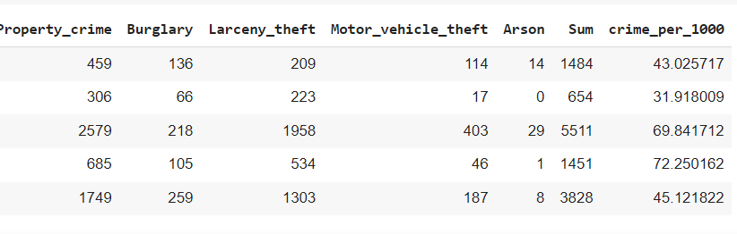
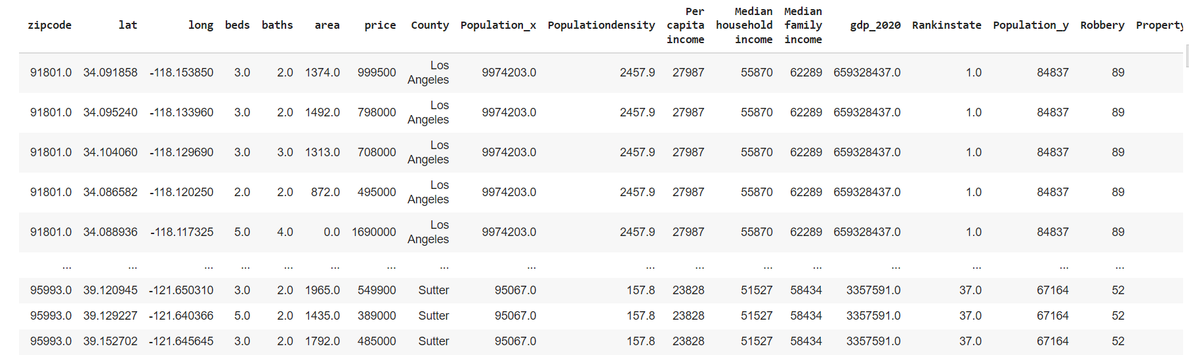
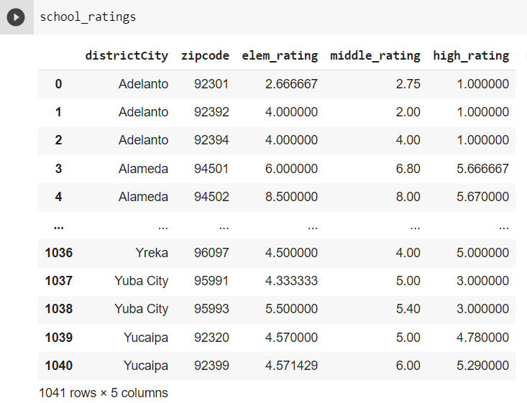
Data Transformation
Data aggregation on schools and crime dataset
Merge individual datasets based on city, zip code.
Label encoding categorical features for modeling.
Aggregated Datasets
Merged Dataset

Slide 13
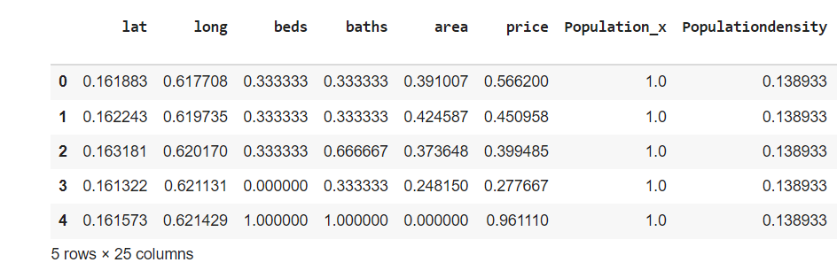
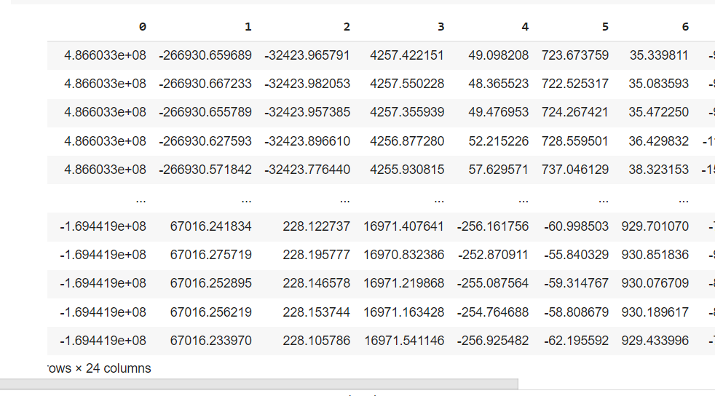
Data Transformation cont…
Normalization on merged dataset using preprocessing methods from python
Principal component analysis for data reduction on the normalized dataset.
Lasso regression did not give better results, and removes many features.

Slide 14
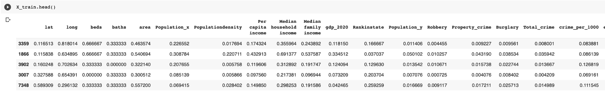
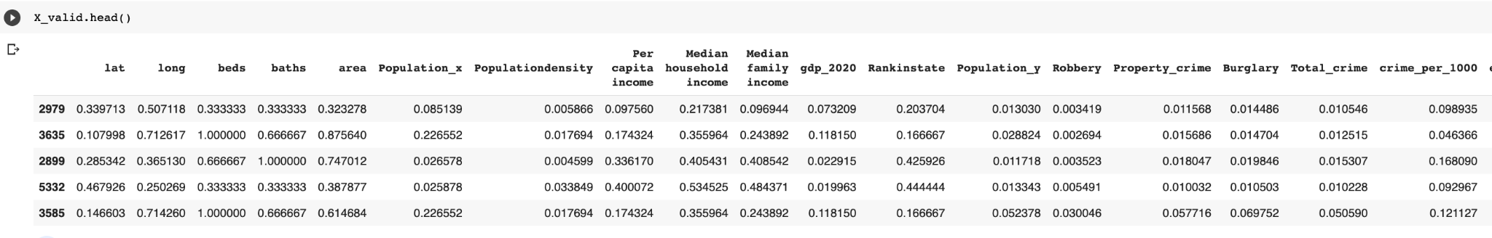
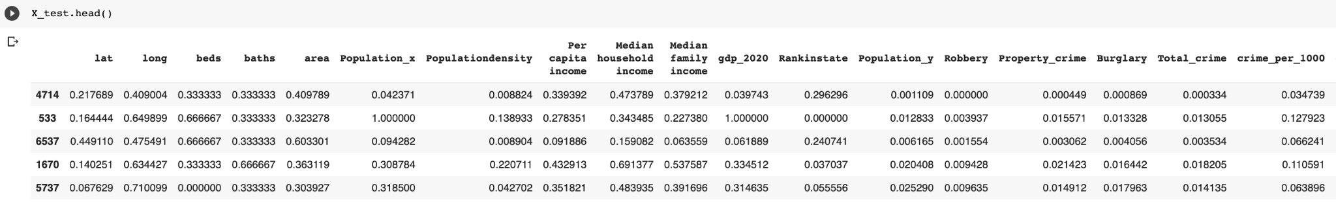
Data Preparation
Normalized dataset is split into training, validation, test sets as 80%training and 20% test
Utilise these datasets for modeling purpose.
Training
Dataset | Statistics ( Rows x Columns ) | Size
Training | 4740 x 21 | 814.7 MB
Validation | 1580 x 21 | 271.6 KB
Test | 1580 x 21 | 271.6 KB
Validation
Testing

Slide 15
Model Development
Random Forest
Artificial Neural Network
Ensemble technique using bagging.
Uses voting and averages from different trees of different samples
Parameters : n_estimators, random_state
XGBoost
Neurons are main components
Interconnected Neurons in a layered architecture < input, hidden, output >
Finds pattern and interconnections between features
Parameters : activation, batch_size, epochs, initializer, loss, optimizer
Ensemble technique using boosting.
combines a weak learners into a strong learner to minimize training errors
Parameters : n estimators, max_depth, learning rate.
K- Nearest Neighbor
Finds the K closest neighbors based on a feature similarities. Distance similarity. ex: Euclidean distance
Outcome will be average of target features of all the K-neighbors.
Parameters : n-neighbors
Notes:
Loss fn -
Learning rate - value must be between 0 and 1, default is 0.3. It determines the step size of each iteration. The higher the run rate the faster the performance.
Od_type
Od_wait
Verbose - Controls the verbosity. The higher, the more messages.

Slide 16
Justification
ANN
Random Forest
Deep learning
Data doesn’t follow a linear regression model, so good choice for non-linearity.
Averaging Bootstraps’ prediction will augment the chances of getting an accurate prediction
XGBoost
KNN-Regressor
Good performance and Fast training. Training method with no overfitting.
Easy to implement non-linearities. Quick model fitting

Slide 17
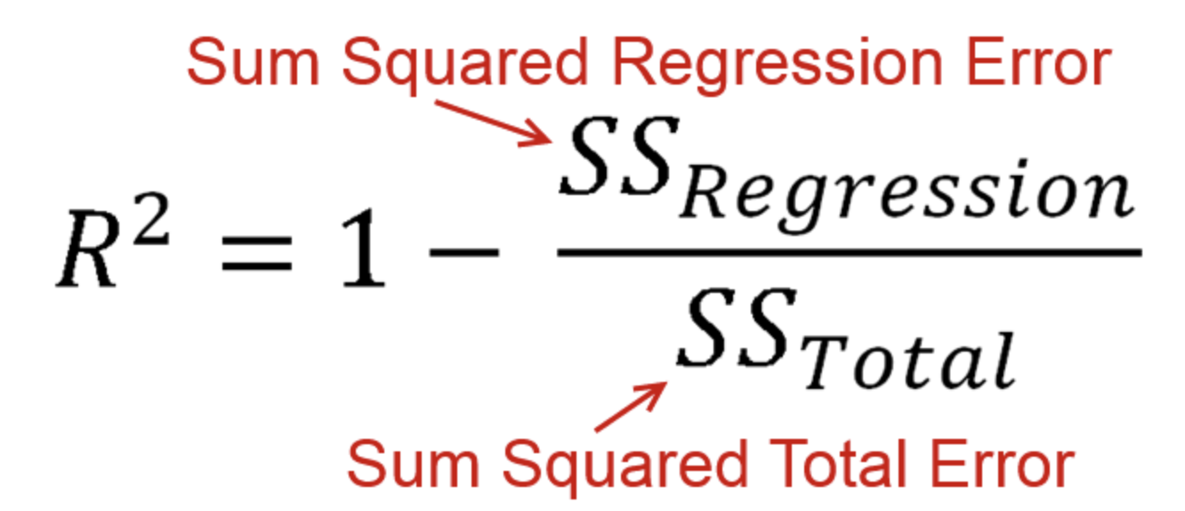
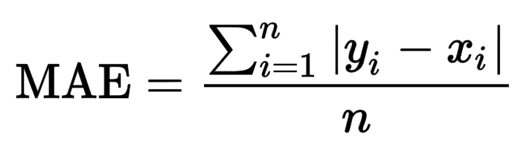
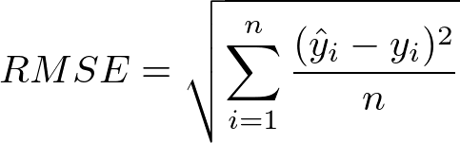
Model Evaluation Metrics :
R-Square
R-Square
Mean Absolute Error
Root Mean Squared Error
t
Shows how well the regression model
explains observed data.
Average magnitude of errors ignoring the sign of the error
Measures how far prediction is from true target using Euclidean distance

Slide 18
Model Comparison
 | Training Dataset |  |  |  | Testing Dataset
 | RMSE | MAE | R2 |  | RMSE | MAE | R2
RF | 0.079 | 0.05 | 0.86 |  | 0.11 | 0.07 | 0.73
ANN | 0.09 | 0.06 | 0.82 |  | 0.11 | 0.07 | 0.72
XGB | 0.12 | 0.1 | 0.74 |  | 0.11 | 0.1 | 0.70
KNN | 0.10 | 0.06 | 0.76 |  | 0.12 | 0.08 | 0.62
New | 0.08 | 0.05 | 0.86 |  | 0.10 | 0.07 | 0.75
The new model was created by averaging the output from XGBoost and ANN

Slide 19
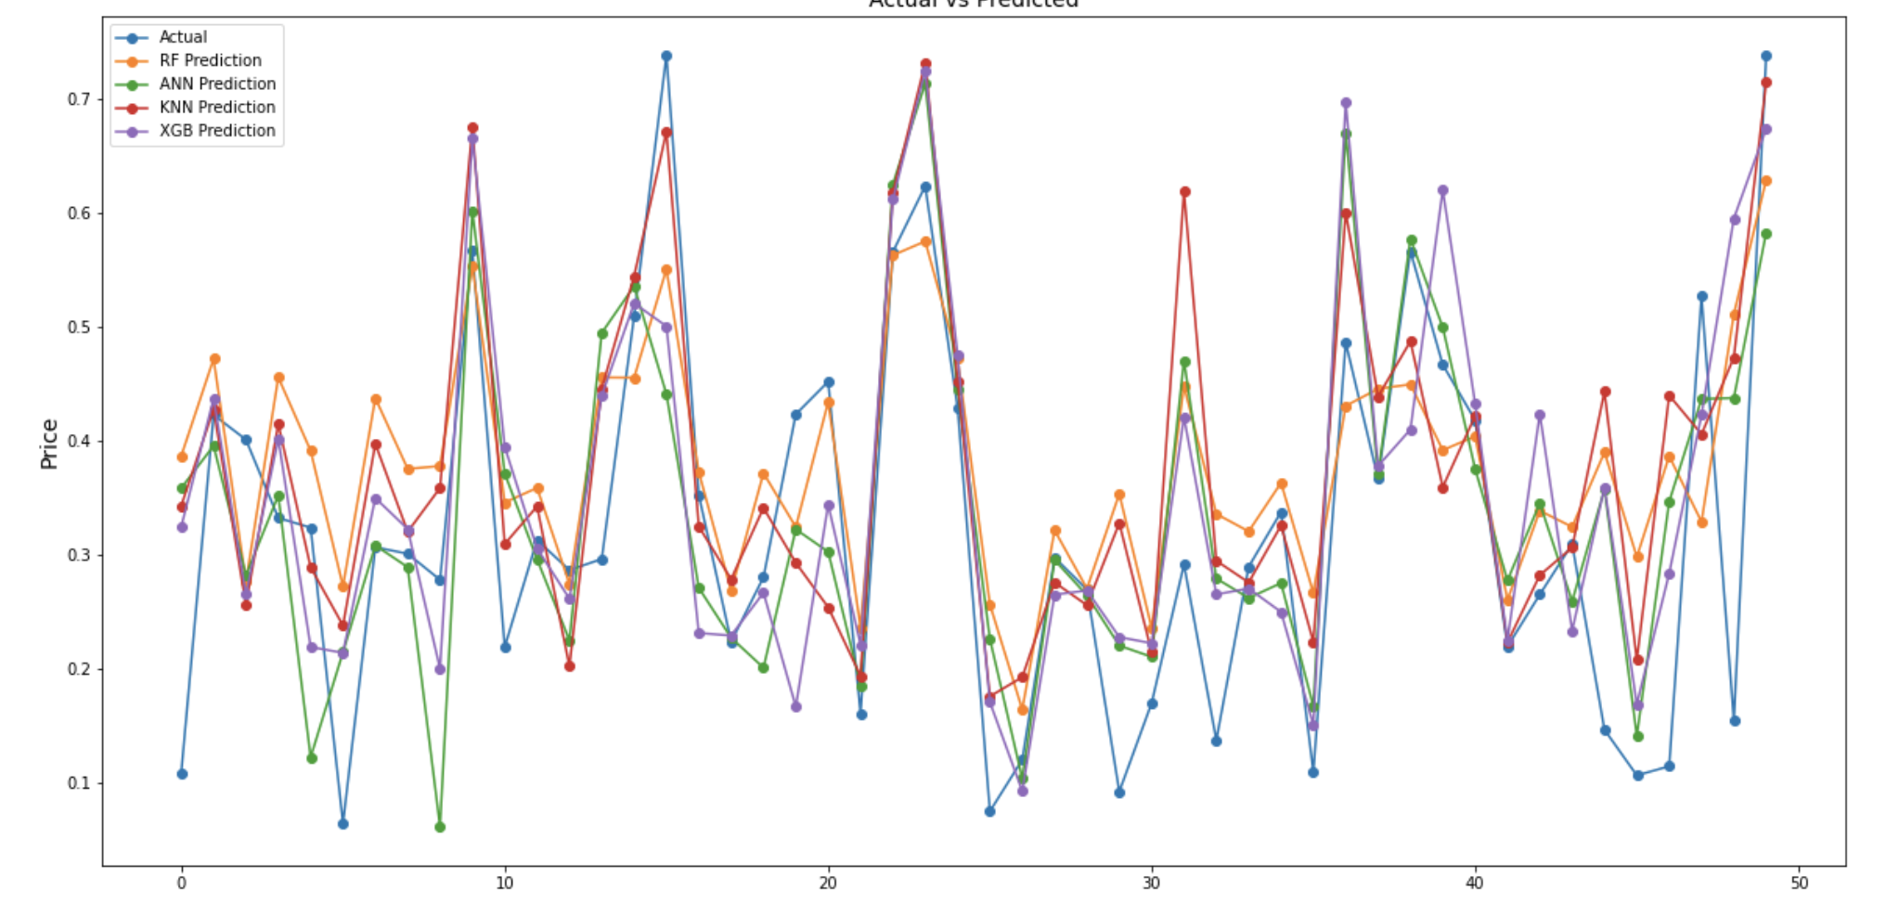
Model Comparison Cont..
Actual vs Predicted

Slide 20
Conclusion
Future Scope
ANN and RF were overfitting the model
KNN was the least performing.
So, New model is the chosen model with best scores
Add more environment features like weather and walk score
Apply other Models not used in this project like Support Vector regression or Gaussian process regression

Slide 21
THANK YOU !
Does anyone have any questions?

